Slide 1
Pre Calculus 12
Ch 8 Geometric Sequences and Series

Slide 2
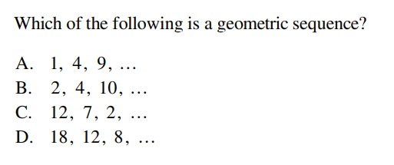

Slide 3
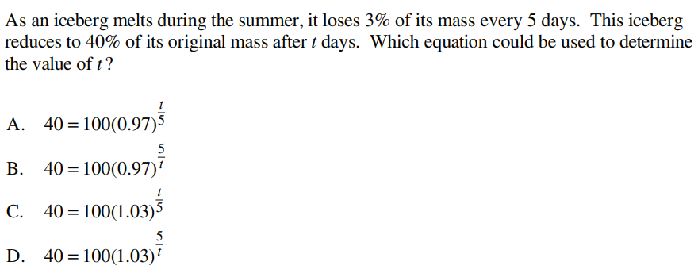

Slide 4


Slide 5


Slide 7



Slide 8


Slide 9


Slide 10
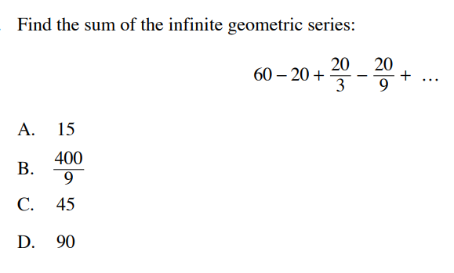

Slide 11


Slide 12


Slide 13
Given the following geometric sequence, which of the following terms are in the sequence? Indicate YES or NO
-384 b) -3072 c) -1536 d) -402653184

Slide 14
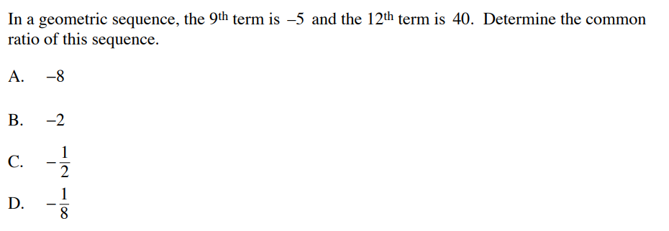

Slide 15


Slide 16
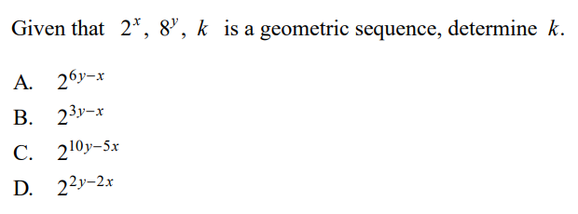

Slide 17
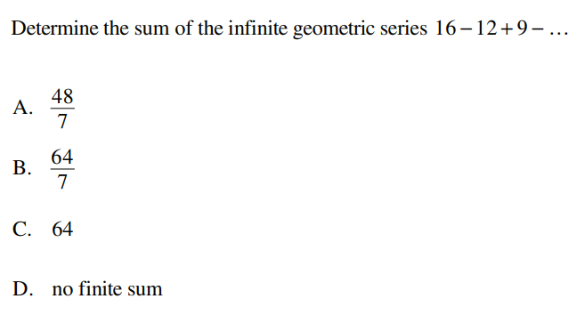

Slide 18
In a geometric sequence, the fourth term is 108 and the sixth term is 243.
What is the value of the common ratio?
What is the value of the first term?
List out the values of the first 6 terms

Slide 19
A ball is bounced such that it always returns back to 65% of it’s previous height. If the ball is released at a height of 10meters, then what is the total vertical distance travelled by the ball before it’s 5th bounce?

Slide 20
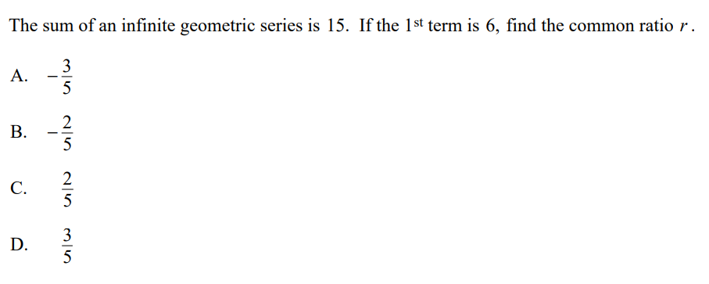

Slide 21
Given that the first three terms of a geometric series is below, for what values of “x” will the sum of the series be convergent ?

Slide 22
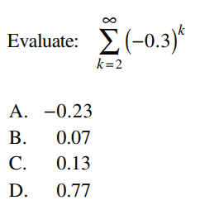

Slide 23


Slide 24
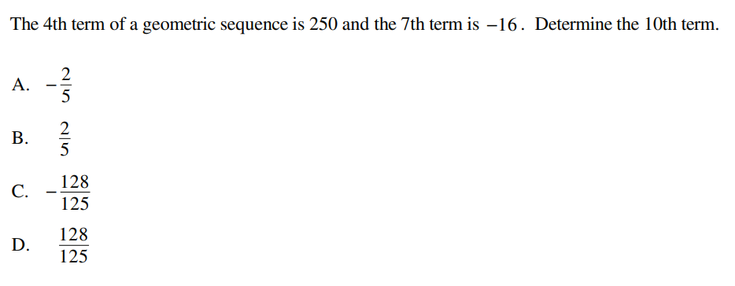

Slide 25


Slide 26
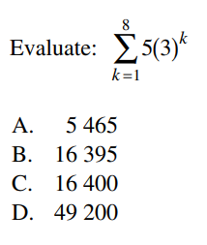

Slide 27
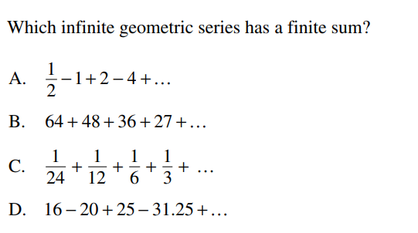

Slide 28
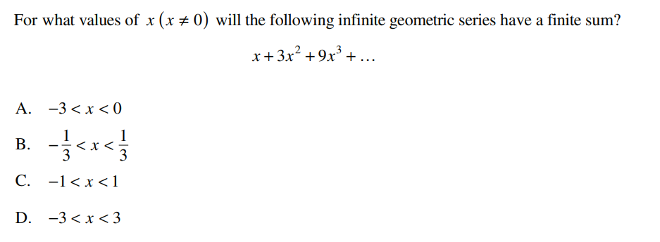

Slide 29
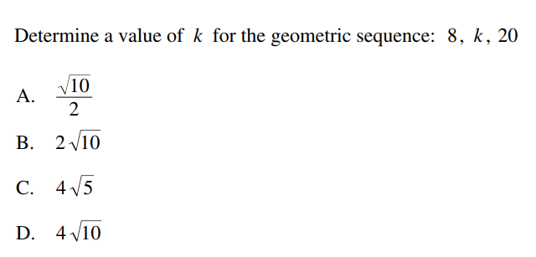

Slide 30


Slide 31


Slide 32


Slide 33
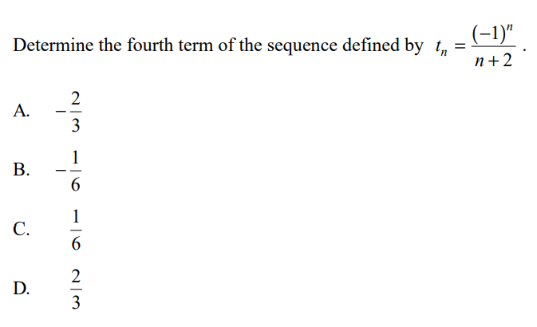

Slide 34
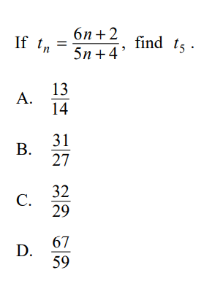

Slide 35


Slide 36
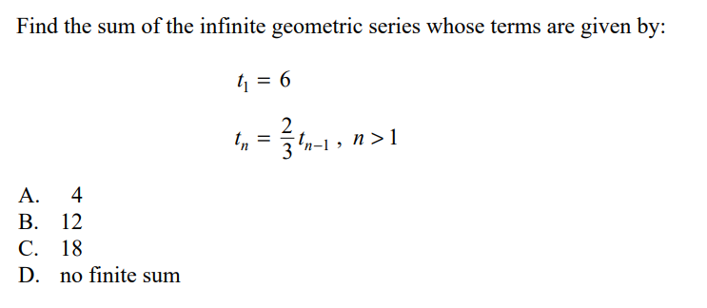

Slide 37


Slide 38
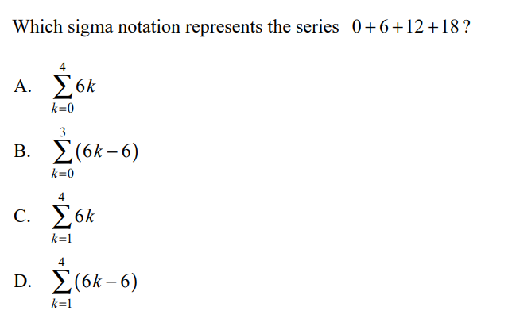

Slide 39
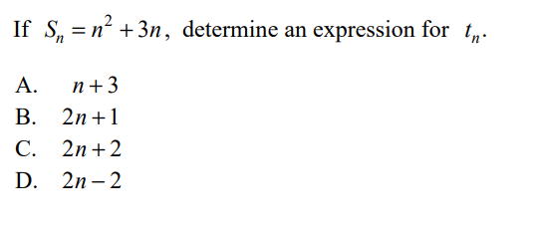

Slide 40


Slide 41


Slide 42
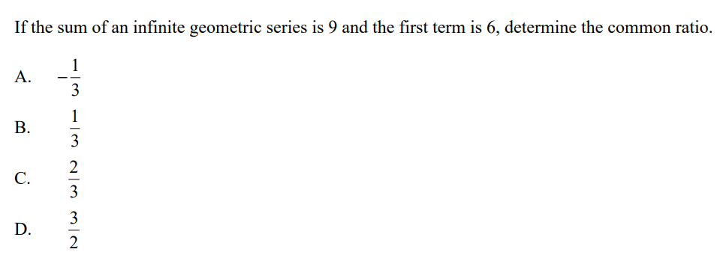

Slide 43
